Slide 1
Behavioral science Toolkit
Prepared by Ben Kertman
March 22, 2017

Slide 2
Behavioral
Eyetracking
Usability Benchmarking (in lab)
Moderated Remote Usability Studies
Unmodertated Remote Panel Studies
Concept Testing
Diary/Camera Studies
Customer Feedback
Desirability Studies
Card Sorting
Clickstream Analysis
A/B Testing
Unmoderated UX Studies
True Intent Studies
Intercept Surveys
Email Surveys
Usability Lab Studies
Ethnographic Field Studies
Participatory Design
Focus Groups
Interviews
Qualitative
Quantitative
Attitudinal

Slide 3
Behavioral
Eyetracking
Usability Benchmarking (in lab)
Moderated Remote Usability Studies
Unmodertated Remote Panel Studies
Concept Testing
Diary/Camera Studies
Customer Feedback
Desirability Studies
Card Sorting
Clickstream Analysis
A/B Testing
Unmoderated UX Studies
True Intent Studies
Intercept Surveys
Email Surveys
Literature Review
Usability Lab Studies
Ethnographic Field Studies
Participatory Design
Focus Groups
Interviews
Heuristics (and Biases) Evaluation
Qualitative
Quantitative
Applying Behavioral Change Theories
Attitudinal

Slide 4
Behavioral Science Additions to the User Research Toolkit
Tool #1: Heuristics (and Biases) Evaluation
Tool #2: Literature Review
Tool #3: Applying Behavioral Change Theories

Slide 5
Tool # 1: Heuristics (and biases) Evaluation

Slide 6
How does it work?
Identify a user flow that we would like to evaluate.
Borrow from a codex of common heuristics and biases that tend to be valid, reliable, and generalizable.
Develop a standard checklist.
Determine whether any items on the list are present in the user flow. If so, do they have positive or negative effect on outcome behavior? Adjust accordingly.
Determine whether any on the list are missing. If so, could they be added to positively affect the outcome behavior. Test.
Improve effectiveness by expanding the list.
Notes:
Validity: appropriateness of the tools, processes, and data. The research question is valid for the desired outcome, methodology is appropriate for answering question, the research design is valid for the method, the sampling and data analysis appropriateness
Reliable: replicability of the process and the results.
Generalizable: the extent of situations and demographics to which these findings can be applied

Slide 7
Example: Recruit and survey beta testers
First line of email (version 1):
You and are invited to sign up for Beta Testing of the SproutsIO microfarm appliance!
First line of email (version 2):
Congratulations, you have been selected to participate in the SproutsIO Beta Testing program!
Currently framed as a task. Opportunity to reframe as a gift and utilize reciprocity.

Slide 8
Example: Recruit and survey of beta testers
Intro to our survey:
We want to thank you again for expressing your interest and choosing to support us from the beginning! That is why you are receiving this exclusive opportunity to be apart of our beta testing. There are many ways in which you can get involved so these following questions will help us determine where you are best fit. Remember, we can’t make an informed decision unless you answer the whole survey.
Privacy Discloser: All of your information collected here is for our own records and will remain completely confidential. Thanks so much and we look forward to working with you!
Would you like to continue?
Yes / No
Heuristics/Biases:
Reciprocity
Scarcity
Priming
Foot-in-the-door

Slide 9
Results:
We were extremely proud of these results, especially since Mailchimp’s statistics indicated that the average click through rate in our area of business was about 13%.
It’s important to note that this was not an experimental study so we don’t know for certain that the results came from our application of the Heuristics (and Biases) Evaluation.
Another potential reason for these outcomes was people’s excitement for the release of the product and eagerness to participate in anyway possible.
Considering that we were still about 70% above the average, it is likely that both of these factors contributed to our success.

Slide 10
How do heuristics (and biases) evaluations help?
Easily conduct evaluations by targeting user flows (onboarding, completing a task, recommending a friend, etc.)
Helps by identifying biases and heuristics that either negatively or positively impact your target behavior.
Provides concrete suggestions of heuristics and biases to avoid or support based on the goals of the desired behavior.
This provides design with direction as to which heuristics and biases they should be designing towards or away from during particular user flows.
Useful during the following design stages…
Discovery
Concept Design
Detailed
Design
Building & Launch
Learn

Slide 11
Tool #2: Literature Review

Slide 12
How does it work?
Examples for Bose headphones
It’s a systematic review of the academic literature.
Specific demographics
Environmental contexts
Stimuli
Outcomes
What is the Behavior / Decision / Effect?
Frequency of the Behavior / Decision / Effect?
Environmental contexts of Behavior / Decision / Effect?
How do various stimuli interact with a target demographic and their behaviors in a given environment?
Prolonged external sound environments (construction workers, concert goers, office space); Age; Gender; Economic status (Eastie airports, highways)
External: social (friends, family, partner, etc); indoors/outdoors; transportation. Internal: emotional state; biology
Frequency range of environment; switching conversations (ordering a meal / talking to partner); receiving a text
Perceived volume; Downloading and using feature on app; comprehension of conversation; memory retention

Slide 13
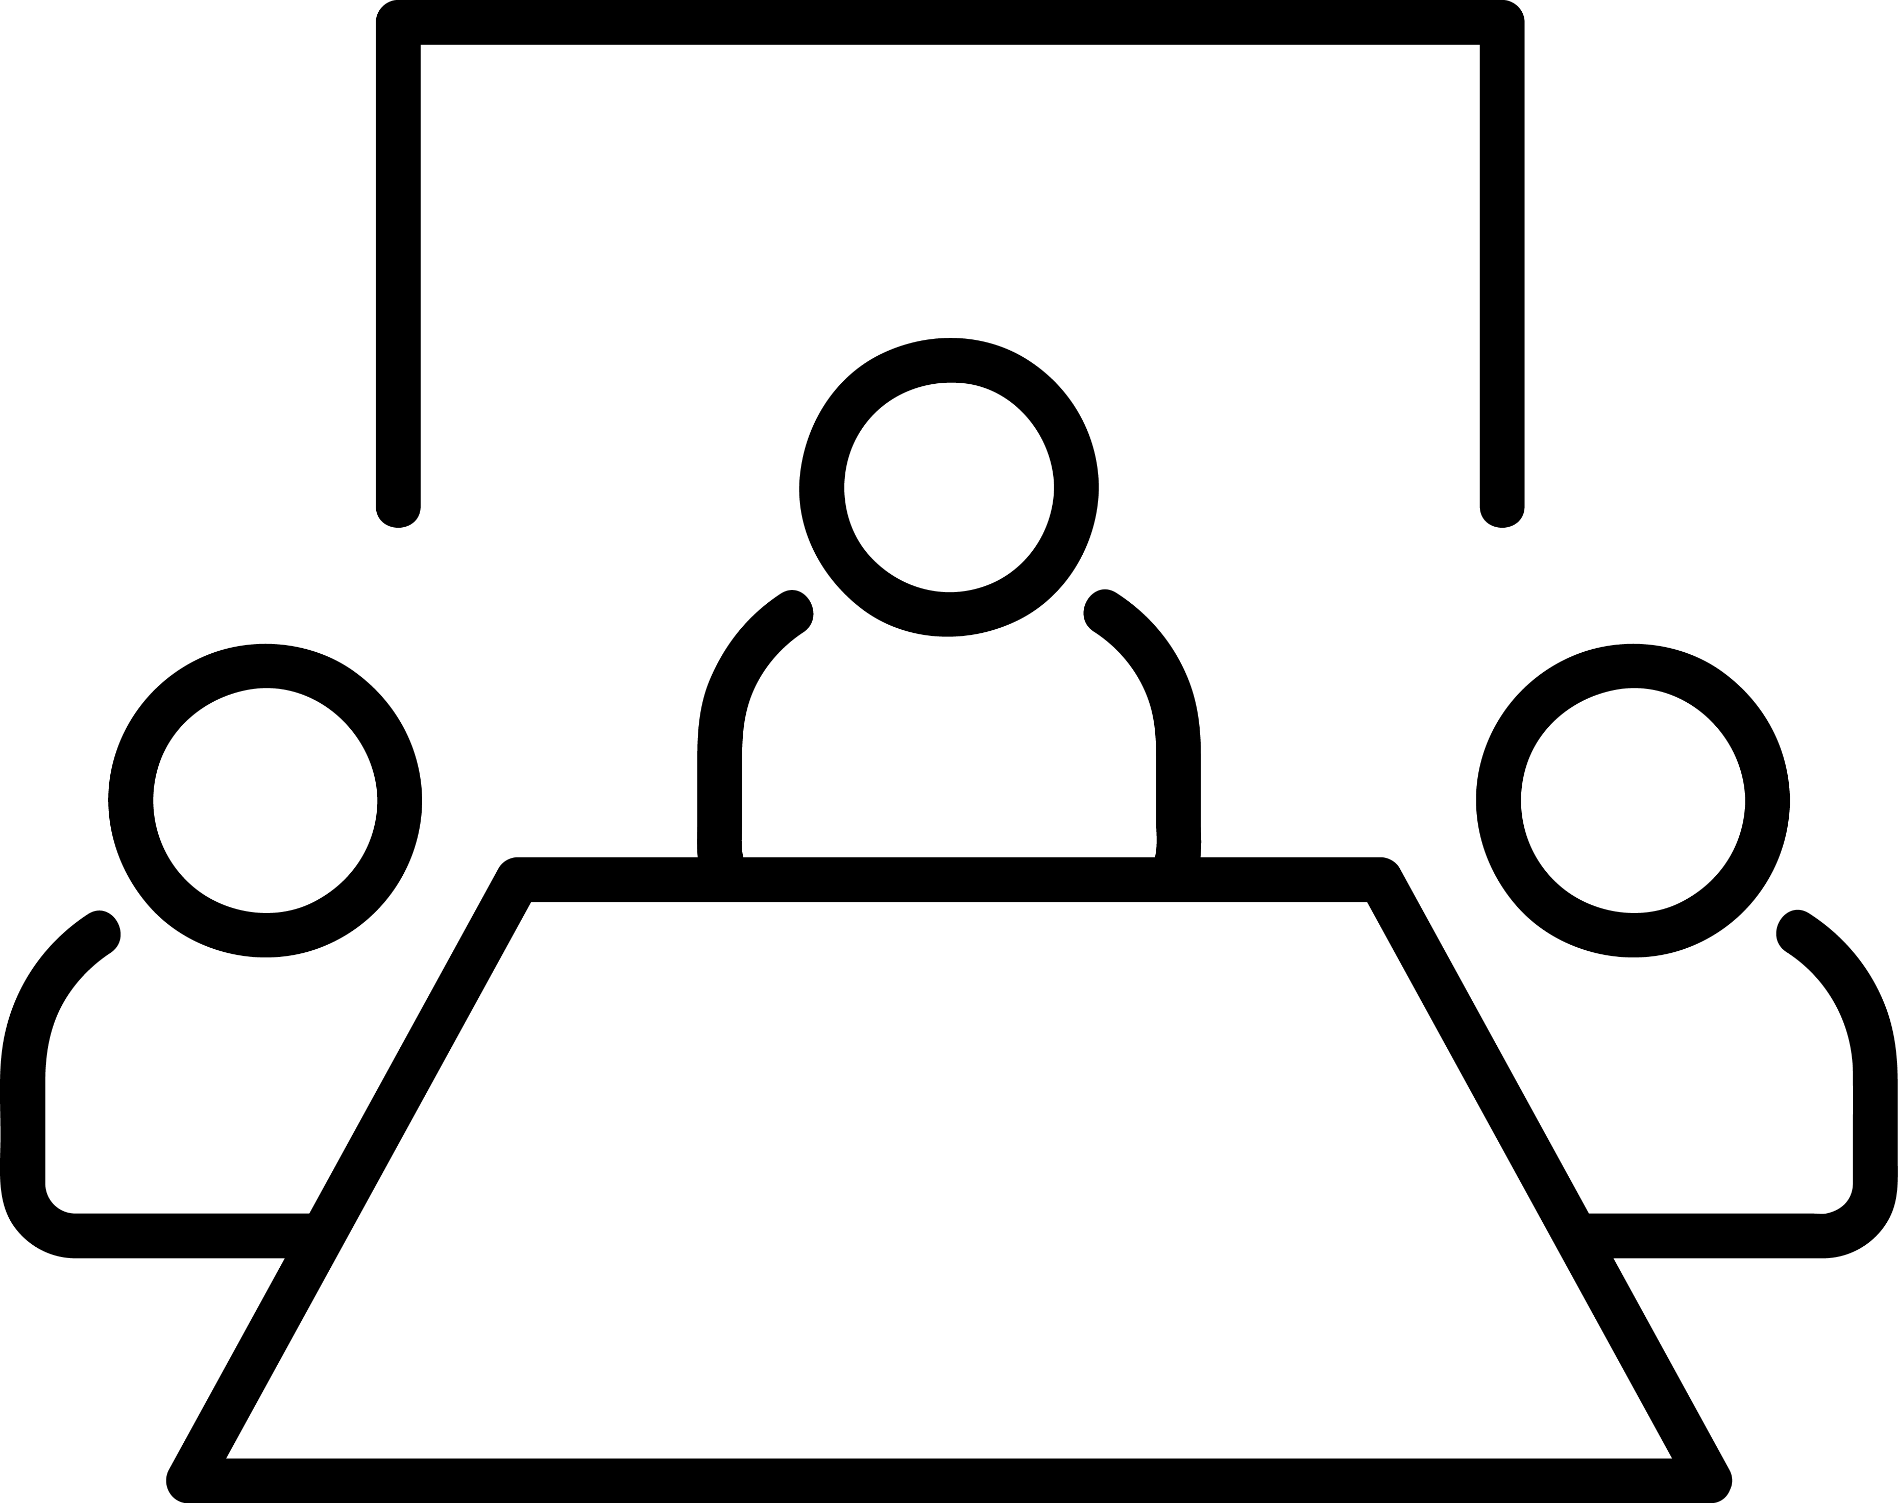
PERSONA PERSPECTIVE
Behavior / Decision Outcome
Environments
Stimuli
?
Comprehension
“Blah blah blah, ,
you got that right?"
Emotion recognition
Multi-tasking

Slide 14
How do Literature Reviews help?
Provides a bird’s eye view of our collective knowledge regarding the interactions between the persona, their environments, exposure to stimuli, and their resulting behaviors.
Identifies current gaps in knowledge.
Surfaces best applicable behavioral theories and models to inform both research and design frameworks.
Useful during the following design stages…
Discovery
Concept Design
Detailed
Design
Building & Launch
Learn

Slide 15
Tool #3: Applying Behavioral Change Theories

Slide 16
How does it work?
Examples: Social Cognitive Theory, Self-Determination Theory, Stages of change model, etc.
We are looking to influence a long-term motivational behavior so we select Self-Determination Theory.
Self-Determination Theory claims that conditions that support…
Competence
Relatedness
Autonomy
…will increase motivation and engagement for targeted behaviors, including enhanced performance, persistence, and creativity.
Literature Review reveals behavioral change theories (causal structure of variables) and/or models of behaviors that relate to the specific persona-environment-stimuli-behavior combination.
Selecting a theory/model to test depends on several internal factors (i.e. business strategy, targeted demographic and behavior, time scale for desired behavior change)
The next step is to break it down into its components to understand the variables that cause behavior change.

Slide 17
Self-Determination Theory
Competence: Is the universal need to seek to control the outcome and experience mastery. The need for competence means the desire to control and master the environment and outcome. We want to know how things will turn out and what the results are of our actions.
How to support competence: Clarity of expectations, by collaboratively setting realistic goals and discussing what to expect and not expect from the behavior-linked outcomes; Optimal challenge, by tailoring strategies and goals to individuals´ skills; feedback, offering clear and relevant informational feedback (e.g. on goal progress), in a non-judgmental manner; Provision of instrumental and practical skills-training, guidance, and support.
Relatedness: The need for relatedness deals with the universal desire to “interact with, be connected to, and experience caring for other people”. Our actions and daily activities involve other people and through this we seek the feeling of belongingness.
How to support relatedness: Empathy, by attempting to see the situation through the client’s perspective; Affection, by displaying genuine appreciation and concern for the person; Attunement, through paying careful attention to and gathering knowledge about the person; Dedication of resources, through volunteering time and energy; Dependability, through availability in case of need.
Autonomy: Is the universal urge to be causal agents of one's own life and act in harmony with one's integrated self; however, Deci and Vansteenkiste[13] note this does not mean to be independent of others. The need for automony concerns with the urge to be causal agents and to act in harmony with our integrated self. To be autonomous does not mean to be independent. It means having a sense of free will when doing something or acting out of our own interests and values.
How to support autonomy: Relevance, by providing a clear and meaningful rationale for activities, facilitating self-endorsement; Respect, by acknowledging the importance of clients’ perspective, feelings, and agenda; Choice, by encouraging clients to follow their own interests and providing options whenever possible; Avoidance of control, by not using coercive, authoritarian, or guilt-inducing language or methods.

Slide 18
Developing Design Framework from Self-Determination Theory
design for competence:
1. calibrate for optimal challenge and mastery
2. provide meaningful feedback (emphasize positive emotion (I want to do more), increased ability (I can do more), call to action (there’s more to do)
design for relatedness:
1. how we can enrich the lives people have with each other (both online and offline)
2. collaborative goals (everybody’s actions contribute to the larger whole)
3. personalize for people (use an empathic tone in the writing)
design for autonomy:
1. understand target audience - desires, preferences, needs, designing empathy
2. learn when to request a behavior - and provide a rationale
3. reduce controlling language
4. allow people to be self-starters - encouraging and offering a moderate amount of choice
*pulled from the work of the Behavior Change Design team at Mad*Pow

Slide 19
How does applying behavioral theory help?
Design with a focus on the persona and their behaviors that we hope to positively motivate.
Design based off of a framework that is substantiated through decades worth of peer-reviewed knowledge.
Useful during the following design stages…
Discovery
Concept Design
Detailed
Design
Building & Launch
Learn

Slide 20
To recap…

Slide 21
The Behavioral Toolkit
Behavioral
Eyetracking
Usability Benchmarking (in lab)
Moderated Remote Usability Studies
Unmodertated Remote Panel Studies
Concept Testing
Diary/Camera Studies
Customer Feedback
Desirability Studies
Card Sorting
Clickstream Analysis
A/B Testing
Unmoderated UX Studies
True Intent Studies
Intercept Surveys
Email Surveys
Literature Review
Usability Lab Studies
Ethnographic Field Studies
Participatory Design
Focus Groups
Interviews
Heuristics (and Biases) Evaluation
Qualitative
Quantitative
Applying Behavioral Change Theories
Attitudinal

Slide 22
On the horizon…
Continue to improve and expand behavioral toolkit
Media Cloud
Python API
Statistical Analyses
Machine Learning (cluster analysis, etc.)
Deep learning (tensor flow, etc.)
New Data Sources
Reddit
Somerville Happiness Index
GIS data of audio pollution

Slide 23
Thank you!

Slide 24
References
Nielsen
Wikipedia
Theory of Self-Determination
More on Theory of Self-Determination
Madpow
Noun project
Made
Arjuazka
Green Store
Souvik Bhattacharjee
Numero Uno
Delwar Hossain
Shashank Singh
Linseed Studio
Gustav Salomonsson
Sara Giacomini
Ananth
Andrejs Kirma
Bezier Master
ArtWorkLeaf

